Slide 1

Spatial and storm-time dependence of electron microburst pitch angle isotropy
Presented by:
Conrad Meyer-Reed
Co-authors:
Lauren Blum, Mike Shumko

Slide 2

Abstract
This study uses electron count data from the SAMPEX satellite to calculate a qualitative measurement of electron pitch angle isotropy associated with microbursts
By correlating microburst isotropy with magnitude, L-Shell, MLT, Dst, and AE, we can better understand the electron loss mechanisms in the Earth’s radiation belts

Slide 3
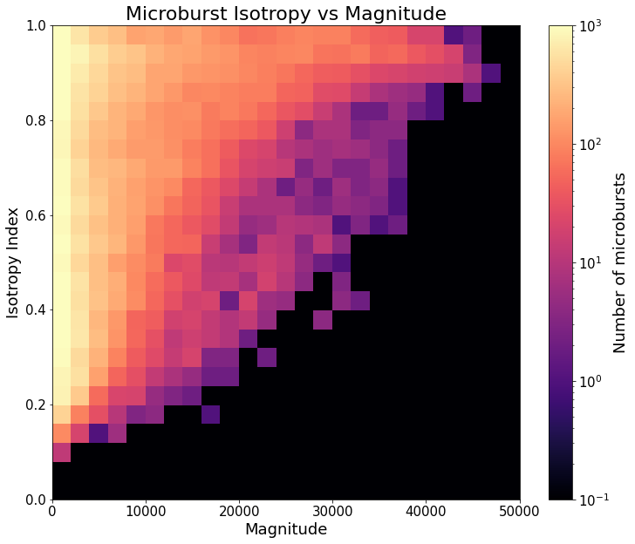
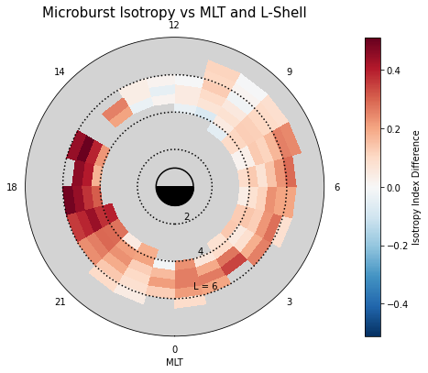
Key Findings
High isotropy corresponds to more electron precipitation; low isotropy corresponds to less electron precipitation
Low magnitude microbursts are widely varying in isotropy; high magnitude microbursts are more isotropic
Median Microburst Isotropy vs MLT and L-Shell
Microburst isotropy compared to background is highest in the evening magnetic local time region and lowest in the noon region
Microburst isotropy compared to background is highest during the initial phase and lowest during the recovery phase of intense geomagnetic storms

Slide 4
Thank you!
Contact information:
Email: Conrad.Meyer-reed@colorado.edu
Cell: (574) 538-8023

